Slide 1

FINAL ASSESMENT – EXCEL
BY SHREYAS SRIDHARAN (4309)

Slide 2
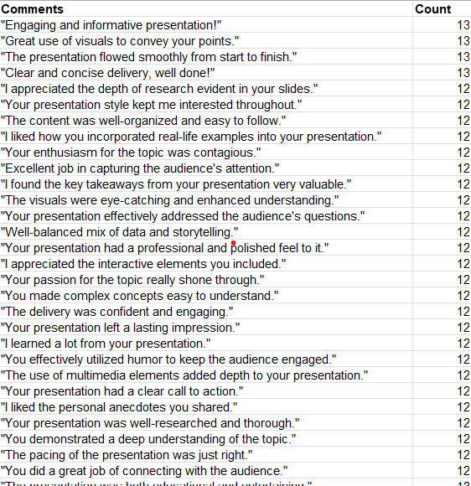
Question 1
Insights – 1. After applying the remove duplicates function across the whole table, I realized that there is no duplicate values found.
2. Except for the comment column, no other column has null or blank values present. While I tried to apply mode for the comment column to fill the null values, I realized that a lot of comments have repeated 13 times as shown in the image on the right, so it would not be feasible to apply mode. So, we can either delete or leave the column as it is

Slide 3
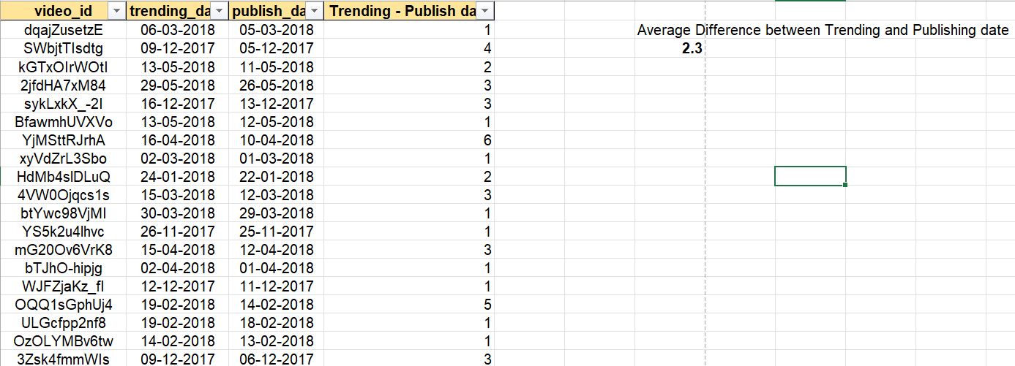
Question 2
<- SNAPSHOT OF THE CALCULATION
Formula used – 1.Trending – Publish date
2. Average(all the Trending – Publish dates)
Steps Involved – 1.Find the difference between trending and publish date and establish it in a new column.
2. Take the average of all the cells of the column ‘Trending – Publish date’ to get the average difference between the dates.
Insights – So when I did some filtering on the dates, I noticed that there were a few cells where the difference between the dates were over 80 days, but once I computed the average, I realized that on average, it takes about 2.3 days for a video to start trending after it has been published. This means it takes about 2 days for the video to reach a large section of the audience and for them to view it

Slide 4


Question 3
<- SNAPSHOT OF THE CALCULATION
Formula used – 1.Average(Views)
2. Engagement Rate = (Total Likes + Dislikes)/Total Views
Steps Involved – 1.Find Average views and Engagement rate for each category
2. Use sorting to sort data based on the highest views first and then do it for the highest engagement rate
Insights – We can notice that Movies have the highest average views but when it comes to engagement rate, we see that pets and animals get more reaction from people per view

Slide 5
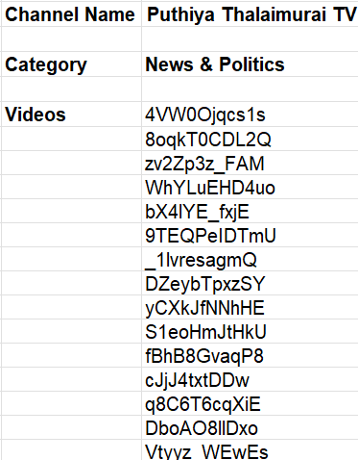
Question 4
<- SNAPSHOT OF THE CALCULATION
Formula used – 1. For Category - XLOOKUP(F5,'Question 3'!D:D,'Question 3'!F:F,"Not Available")
2. For finding videos - FILTER('Question 3'!A:A,'Question 3'!D:D='Question 4'!F5,"Not Available")
Steps Involved – 1.Using Xlookup, found the category that the channel belonged to
2. Using the filter formula, found all the videos that belonged that particular channel title.
Insights – If we create a data validation of all the channel names, we can find all the unique videos for each channel title.

Slide 6
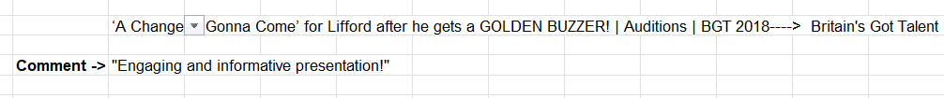
Question 5
<- SNAPSHOT OF THE CALCULATION
Formula used – 1. Used CONCAT() to join title and channel title
2. For finding comments - TEXTJOIN(",",TRUE,FILTER(Q:Q,R:R=V3,"Not Available"))
Steps Involved – 1.Used CONCAT() formula to join title and channel title. Created data validation drop down for each title-channel title combo
2. Using the filter and text join combination on the comments column, found respective comments for each video
Insights –Since a lot of comments are absent, only a few videos have comments enabled, so for most videos, a 0 or null value will be present

Slide 7
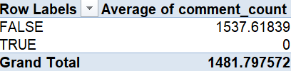
Question 6
<- SNAPSHOT OF THE CALCULATION
Formula used – Used Pivot table to do the calculations
Steps Involved – 1. Inserted the Is_comments_disabled column in row, and then added the comment_count to values
2. Used average values for comment_count under the values drop down of pivot table
Insights – 1. Here, FALSE indicates that the comments haven’t been disabled and TRUE indicates that it has.
2. So as per logic, TRUE is supposed to have zero since disabled comments don’t allow people to comment, and as per our analysis, the hypothesis is true.

Slide 8
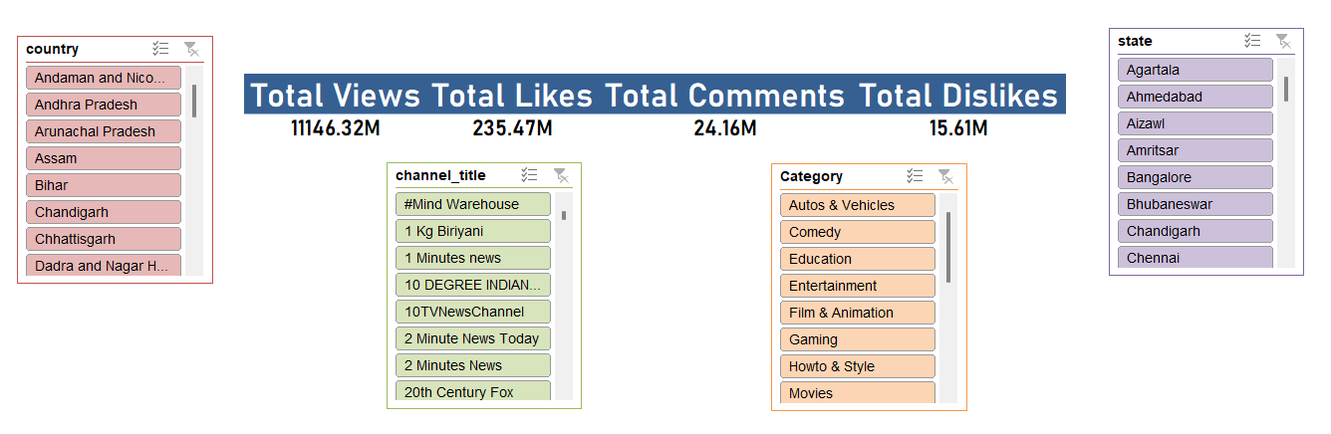
Question 7
<- SNAPSHOT OF THE CALCULATION
Formula used – Used Pivot table to do the calculations
Steps Involved – 1. Inserted Views, Likes, Dislikes and Comments under the values tab
2. Converted everything to sum aggregation
Insights – 1. Here, we can see that Total likes is almost 20 times more than the total dislikes.
2. Another interesting aspect is that the total comments is more than the total dislikes
3. Introducing multiple categorical slicers helps In delving more deep into the data, based on the requirement

Slide 9
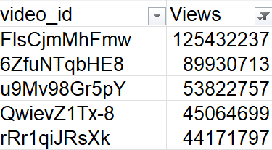
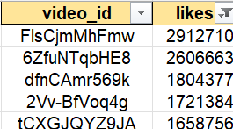
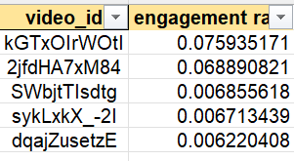
Question 8
<- SNAPSHOT OF THE CALCULATION
Formula used – Sorting
Steps Involved – 1. Sorted data separately for each column, then using filters found the top 5
Insights – 1. We can see that the first two videos in views and likes are the same.
2. We also notice that, videos with high views and likes don’t always have high engagement rate

Slide 10
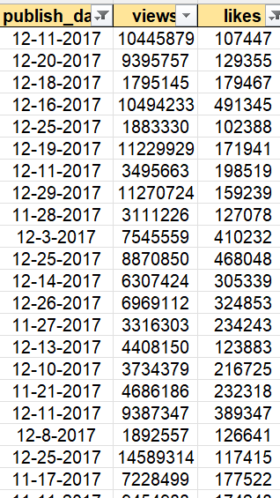
Question 9
<- SNAPSHOT OF THE CALCULATION
Formula used – Sorting
Steps Involved – 1. Filtered data for publish year 2017
2. Then filtered data based on likes > 100000
Insights – 1. We can see that there are a total of 112 videos
2. Of the total of 4358 videos In 2017, only 2.56 percent of the videos have likes greater than 100000

Slide 11
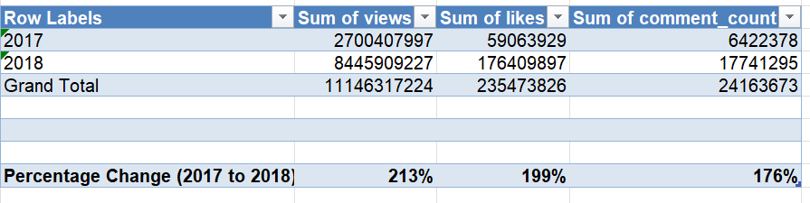
Question 10
<- SNAPSHOT OF THE CALCULATION
Formula used – Pivot tables and Percentage Change formula
Steps Involved – 1. Used pivot tables to find sum of views, likes and comments in both the years
2. Used percentage change formula to find growth in all three metrics from 2017 to 2018
Insights – 1. We can see that each metric has had a significant growth in 2018 as compared to 2017
2. The views as such as grown over 200 percent since 2017 which is a marvellous growth and indicates the number of users who has started using youtube has grown significantly this year (2018)

Slide 12
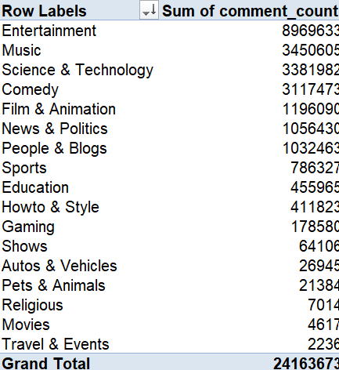
Question 13
<- SNAPSHOT OF THE CALCULATION
Formula used – Pivot tables
Steps Involved – 1. Add Category under rows and sum of comment count under values
Insights – 1. We can see that Entertainment has the highest comments, which indicates people like to spend more leisure time on youtube
2. It is almost thrice as more than the second best, which is music
3. Suprisingly, Movies has the second lowest number of comments when it comes to youtube

Slide 13
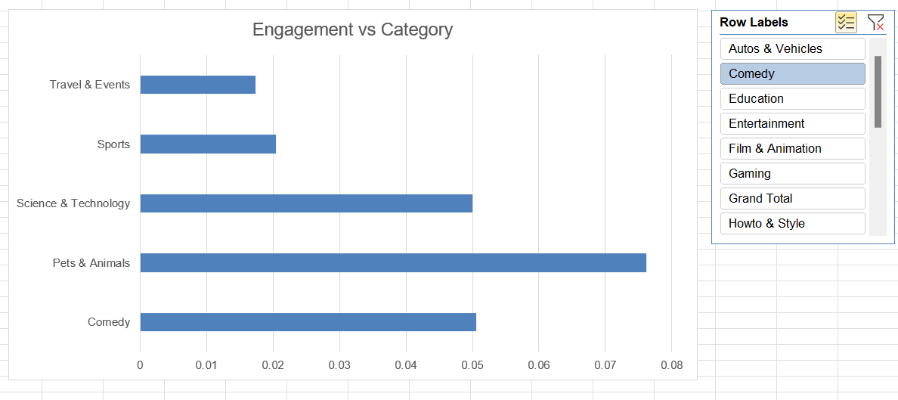
Question 14
<- SNAPSHOT OF THE CALCULATION
Formula used – Pivot tables and Charts
Steps Involved – 1. Add Category under rows and sum of views, likes and dislikes under values
2. Then create the metric Engagement rate, and then create a pivot chart between category and engagement rate
3. Add a slicer to make it more dynamic
Insights – 1. I have used slicer and have included around 5 categories
2. Here we can see that pets and animal have the highest engagement and surprisingly, sports has a low engagement compared to many other categories

Slide 14
Question 15
<- SNAPSHOT OF THE CALCULATION
Formula used – CORREL(array1,array2)
Steps Involved – 1. use correlation formula between views and likes, views and comments and comments and likes
Insights – 1. We can see that there is a strong positive correlation between Views and likes, which indicates that as views increases, likes increases and vice versa
2. While the correlation is slightly less strong between views and comments, it still indicates a good positive correlation
3. Likes and Comments also has a strong positive correlation.

Slide 15
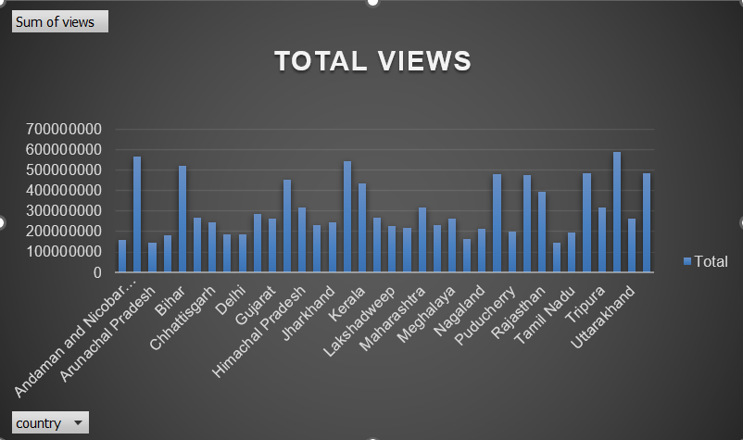
Question 16
<- SNAPSHOT OF THE CALCULATION
Formula used – pivot table and chart
Steps Involved – 1. State In rows and total views in values
Insights – 1. We can see that there are multiple states that have very high number of views but surprisingly delhi being the capital has very less number of views in youtube from public

Slide 16
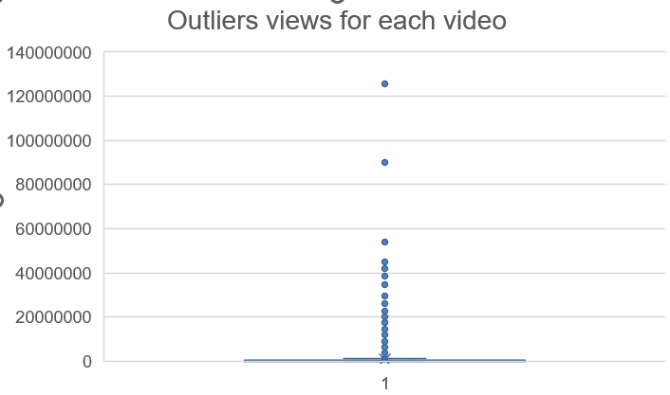
Question 17
<- SNAPSHOT OF THE CALCULATION
Formula used – pivot table and chart
Steps Involved – 1. Video id in rows and views in values
2. Plotting using a box plot
Insights – 1. We can see that there are some videos with exceedingly large views which is way higher than the mean or median of the values so these are shown by the dotted points

Slide 17
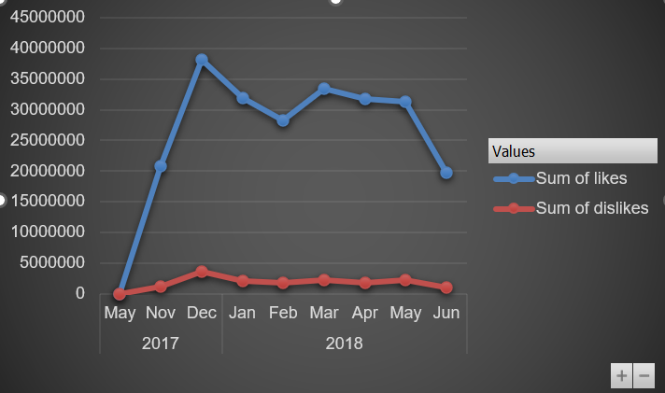
Question 18
<- SNAPSHOT OF THE CALCULATION
Formula used – pivot table and chart
Steps Involved – 1. Months and years in rows and Likes and dislikes in values
Insights – We can see that in dec 2017, it had max number of tota likes and total dislikes together, which could indicate high number of views
2. Jun 2018 had very low number of likes and dislikes due to lower number of viewers

Slide 18
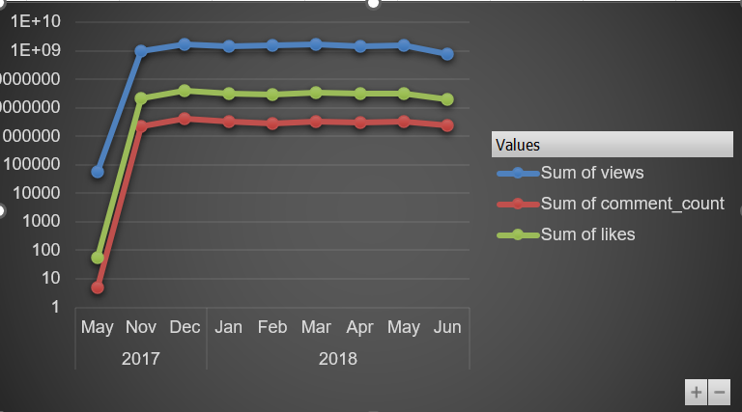
Question 19
<- SNAPSHOT OF THE CALCULATION
Formula used – pivot table and chart
Steps Involved – 1. Months and years in rows and Likes, views and comment count in values
Insights – I have converted this into log scale for clear visualization but we can see that nov 2017 has noticed a steay rise in the likes, views and comments and there has been a constant number from jan 2018 onwards till jun 2018

Slide 19
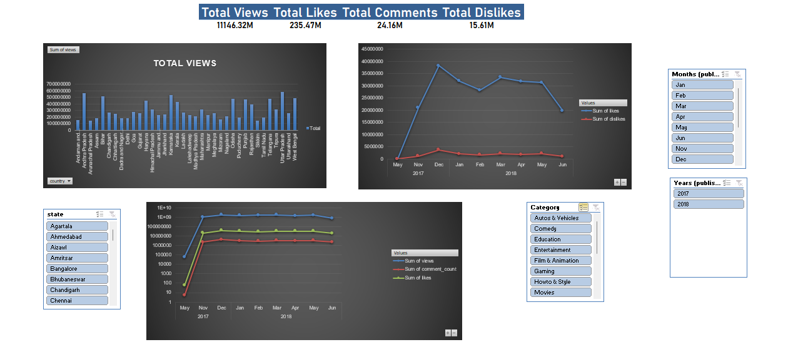
DASHBOARD
Form

